Slide 1

Annotating predicates for the Mandarin conversation project

Slide 2
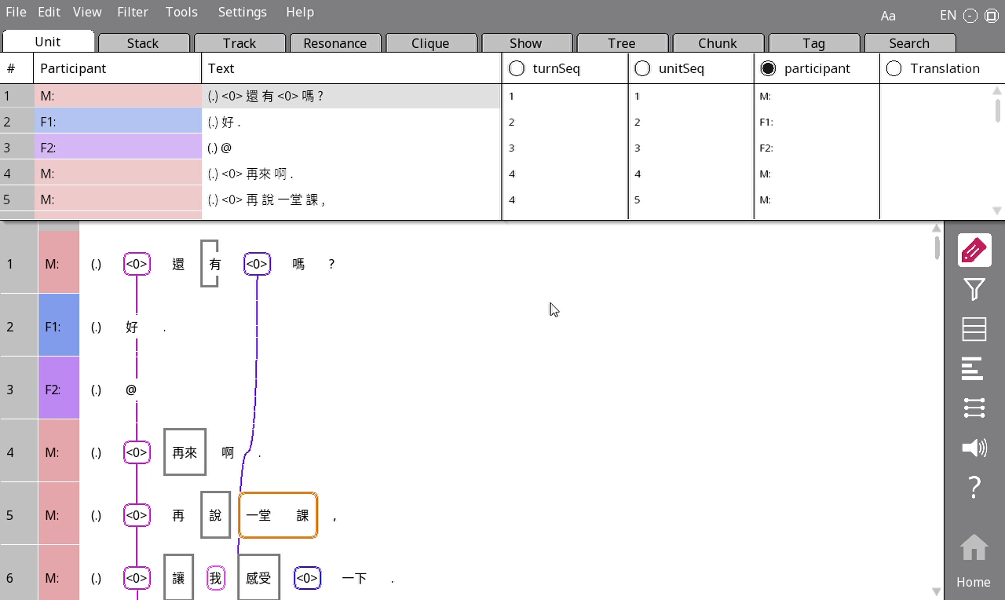
Translating units
Go to Unit > Translation for this
You technically only need to translate lines (intonation units) where there is a subject, but most lines will have one, so it’s probably easier to just translate everything

Slide 3
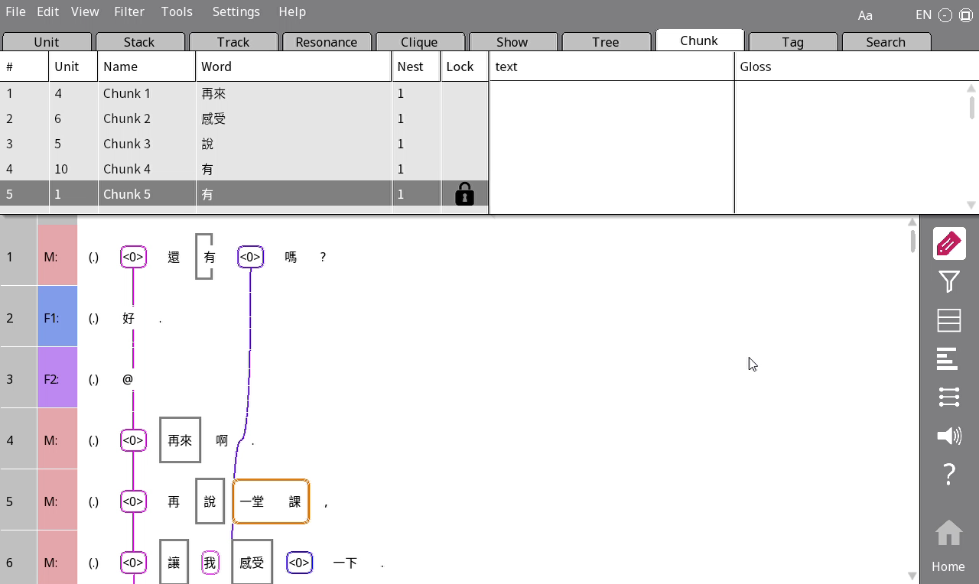
Translating predicates
Translate the verb in the Gloss column within Chunks.
Just put all the verbs in the present tense. No need to use the correct tense.

Slide 4
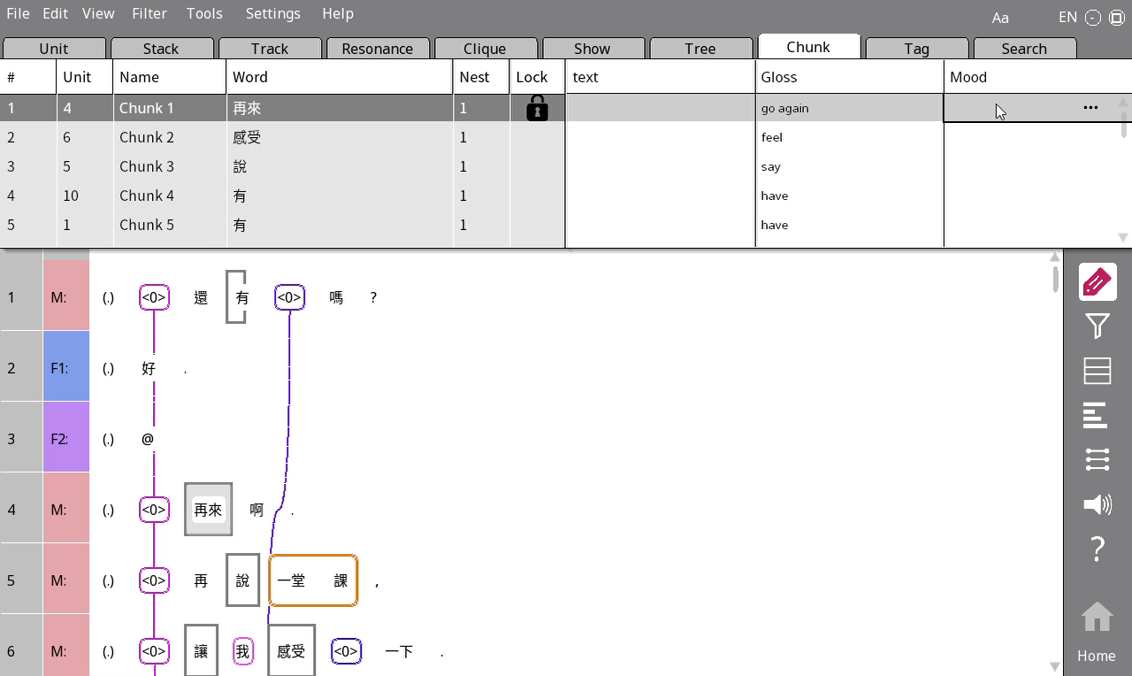
Identifying moods
If the verb belongs to an imperative (i.e. command), put the letter I under Mood.
Otherwise put C.

Slide 5
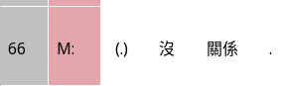
Impersonal
If a verb is impersonal, i.e. there is no real subject (e.g. 今日很熱), put Y there.
Otherwise put N. (You can leave blank if it’s N; we’ll add the Ns back programmatically)

Slide 6
FAlseStart
Put Y under FalseStart if the verb is part of something that was not finished, e.g. 我喜歡- 我喜歡吃蘋果

Slide 7
Integration
First, we look at whether the subject of the current verb is coreferential with an argument of the previous verb. If it does not, we put D (No integration).
If the subject is coreferential with an argument of the previous verb, there are several possibilities:
Obligatory_Coref (M): Grammatically, the two verbs are integrated into one clause, where the argument in the first verb is always the subject of the second verb. E.g. 我幫你找考古題 – the subject of 找 is always the subject of 幫, we can’t have a situation where we say 我幫你找考古題 but the person who does the searching is the 你. So we put M for 找.
No_Obligatory_Coref (N): Similar to M, but coreference is not necessary. E.g. 我想去 vs 我想你去 – the 去 is N in these cases, because 想 doesn’t mean necessarily that the subject of 想 is the same as the subject of 去.
Subordinate (從屬關係, S): The two clauses have unequal status. 如果你想去的話，就去吧。
Coordinate (並列關係, C): The two clauses have equal status and are separated by a conjunction (連詞). 他喜歡吃蘋果，而且每天都吃。
Answer (A): The current clause is an answer to the previous clause. E.g. 你喜歡吃蘋果嗎? 喜歡.
Parataxis (P): The two clauses are just put next to each other with no special relationship. Basically, we choose this if everything else doesn’t fit. 天天吃蘋果，醫生遠離我

